Slide 1

WORK, POWER AND ENERGY
Presented By: Mr. mark ofori nketia

Slide 2
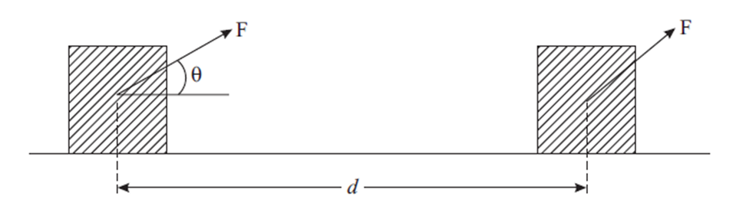
WORK
Let us suppose that a constant force F acting on an object results in displacement d i.e. moves it by a distance d along a straight line on a horizontal surface, as shown in below. The work done by a force is the product of the magnitude of force component in the direction of displacement and the displacement of this object. The unit of work is joule. One joule is defined, as the work done by a force of one newton when it produces a displacement of one metre.

Slide 3
If force F is acting at angle θ with respect to the displacement d of the object, its
component along d will be F cos θ. Then work done by force F is given by
W = F cosθ.d
In vector form, the work done is given by:
W = F. d
Note that if d = 0, W = 0. That is, no work is done by a force, whatever its
magnitude, if there is no displacement of the object. Also note that though both
force and displacement are vectors, work is a scalar.

Slide 4
Dimensional formula of work
W = Force × Distance
= Mass × Acceleration × distance
Dimension of work = [M] × [LT–²] × [L]
= [ML²T–2]

Slide 5
Example
A force of 6 N is applied on an object at an angle of 60º with the
horizontal. Calculate the work done in moving the object by 2m in the horizontal direction.
Solution:
we know that
W = Fd cosθ
= 6×2 × cos 60º
= 6×2 × (½)
= 6 J

Slide 6
Example 2:
A person lifts 5 kg potatoes from the ground floor to a height of 4m to bring it to first floor. Calculate the work done.
Solution:
Since the potatoes are lifted, work is being done against gravity.
Therefore, we can write
Force = -mg
= 5 kg× 9.8 m s–²
= 49 N
Work done = 49 × 4 (N m)
= -196 J

Slide 7
Positive and Negative Work Done
Positive work follows when the force has a component parallel to the displacement. Positive work adds energy to a system. Negative work follows when the force has a component opposite or against the displacement.
When we press the accelerator of the car, the force is in the direction of motion of the car. As a result, we increase the speed of the car. The work done is positive.
When we apply brakes of a car, the force is applied in a direction opposite to its motion. The car loses speed and may finally come to rest. Negative work is said to have been done.
In case the applied force and displacement are as right angles, i.e. θ = 90º, no work is said to be done.

Slide 8
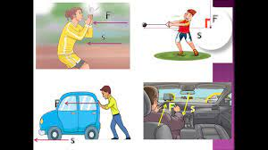

Slide 9
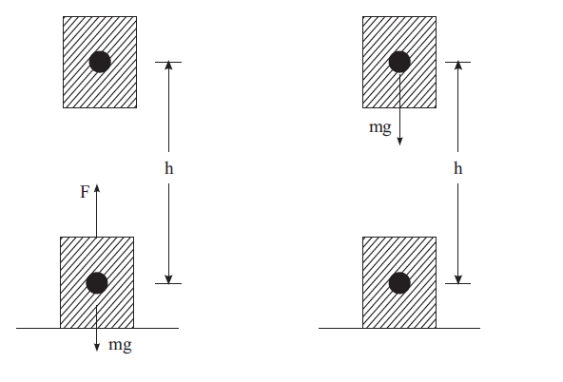
Work Done by the Force of Gravity
Negative work done
Objective is lifted up.
The force moves opposite
to gravitational force
Positive work done
Objective moves down.
The force moves in the direction of gravitational force
W = Fd cos 0º
= + mgh
W = Fd cos 0º
= - mgh

Slide 10
Question
A force F = (5ˆi +3 ˆj ) acts on a particle to give a displacement d = (3ˆi + 4 ˆj )m
(a) Calculate the magnitude of displacement
(b) Calculate the magnitude of force.
(c) How much work is done by the force?

Slide 11
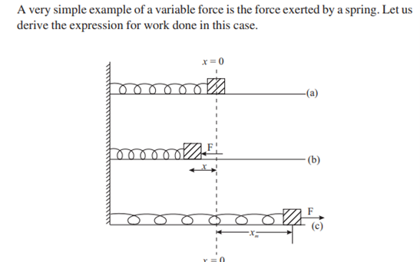
Work Done by a Spring
A spring-mass system whose one end is rigidly fixed and mass m, rests on a
smooth horizontal surface.
(a) The relaxed position of the spring’s, free end at x = 0;
(b) The spring is compressed by applying external force F and
(c) Pulled or elongated
by an external force F. The maximum compression/ elongation is xm.

Slide 12
According to Hooke’s law (true for small x only), |Fs | = kx, where k is known as spring constant. Since the direction of Fs is always opposite to compression (or extension), it is written as : F = Fs = – kx
“the work done by the external force is positive but the work done by the spring force is negative and its magnitude is (½) Kx²

Slide 13
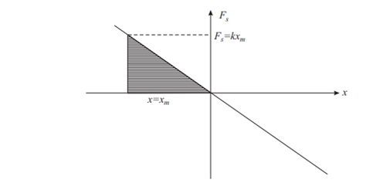
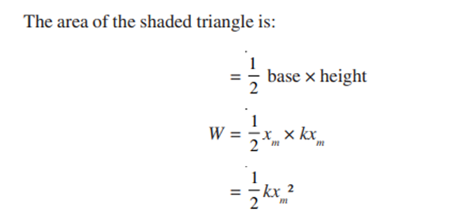
Graphical Presentation of Work done by a Spring

Slide 14
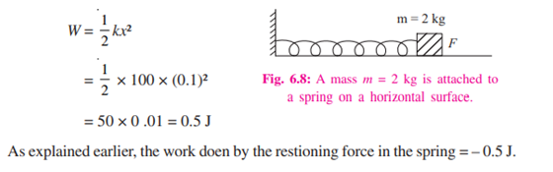
Example:
A mass of 2 kg is attached to a light spring of force constant
k =100 Nm–1. Calculate the work done by an external force in stretching the spring by 10 cm.
Solution:

Slide 15
POWER
Definintion: The rate at which work is done is called power.
The unit of power is joule/ second = watt
If ΔW work is done in time Δt, the average power is defined as
Average Power = Work done
time taken

Slide 16
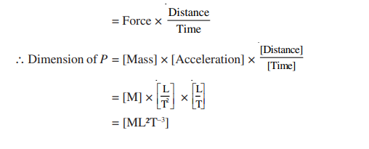
The dimensions of power
P = Work
Time

Slide 17
ENERGY
As you know, the capacity to do work is called energy. If a system (object) has energy, it has ability to do work. An automobile moving on a road uses chemical energy of fuel (CNG, petrol, diesel). It can push an object which comes on its way to some distance. Thus it can do work. All moving objects possess energy because they can do work before they come to rest. We call this kind of energy as kinetic energy.
Kinetic energy is the energy of an object because of its motion

Slide 18

Let us consider an object of mass m moving along a straight line when a constant force of magnitude F acts on it along the direction of motion. This force produces a uniform acceleration a such that
F = ma.
Let v₁ be the speed of the object at time t ₁ . This speed becomes v₂ at another instant of time t ₂ . During this interval of time t = (t ₂ – t ₁ ), the object covers a distance, s. Using Equations of Motion, we can write

Slide 19
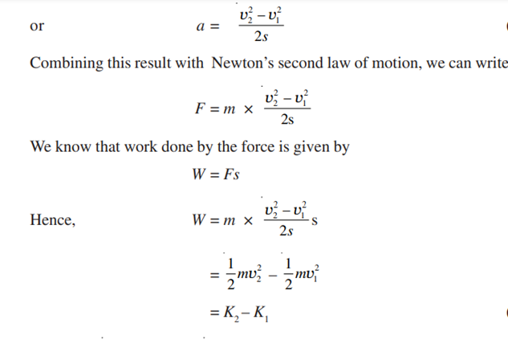

Slide 20

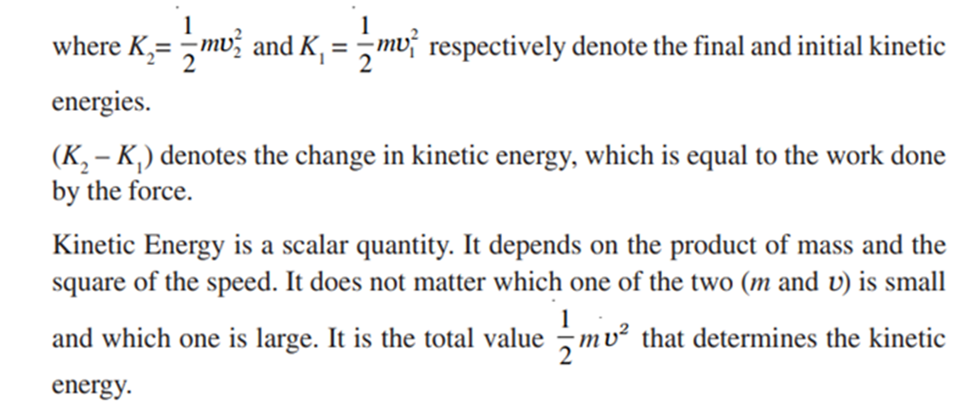

Slide 21
POTENTIAL ENERGY
Objects possess another kind of energy due to their position in space. This energy is known as Potential Energy. Familiar example is the Gravitational Potential Energy possessed by a body in Gravitational Field.

Slide 22
Potential Energy in Gravitational Field
W = force × distance = mgh
The work is positive and is stored in mass (m) as energy. This energy by virtue of the position in space is called gravitational potential energy. It has capacity to do work. If this mass is left free, it will fall down and during the fall it can be made to do work. For example, it can lift another mass if properly connected by a string, which is passing over a pulley.

Slide 23
Example:
A truck is loaded with sugar bags. The total mass of the load and the truck together is 100,000 kg. The truck moves on a winding path up a mountain to a height of 700 m in 1 hour. What average power must the engine produce to lift the material?

Slide 24
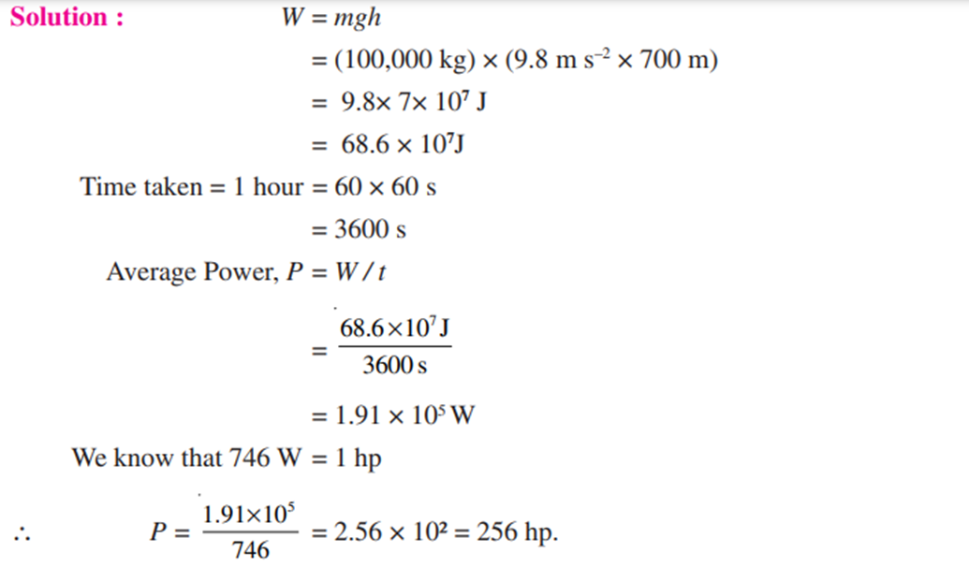

Slide 25
Question:
Hydroelectric power generation uses falling water as a source of energy to turn turbine blades and generate electrical power. In a power station, 1000 × 10³ kg water falls through a height of 51 m in one second.
(i) Calculate the work done by the falling water?
(ii) How much power can be generated under ideal conditions?

Slide 26
Example
A body of mass 10 kg is initially moving with a speed of 4.0
m s–1. A force of 30 N is now applied on the body for 2 seconds.
(i) What is the final speed of the body after 2 seconds?
(ii) How much work has been done during this period?
(iii) What is the initial kinetic energy?
(iv) What is the final kinetic energy?
(v) What is the distance covered during this period?
(vi) Show that the work done is equal to the change in kinetic energy?

Slide 27
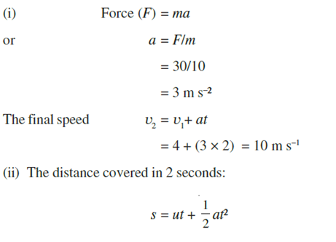
Solution

Slide 28
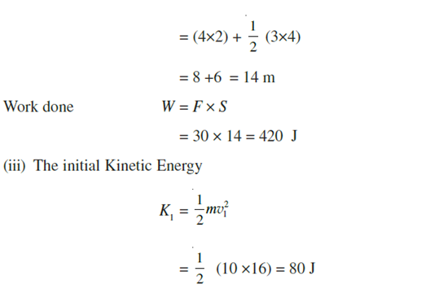

Slide 29
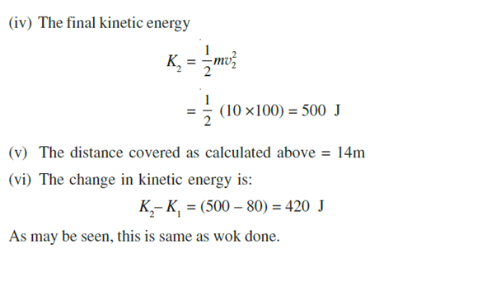

Slide 30
Recap
Work done by a constant force F is
W = F.d = Fd cosθ
Where θ is the angle between F and d. The unit of work is joule. Work is a scalar quantity.
Mechanical energy of a system exists in two forms (i) kinetic energy and (ii) Potential energy.
The Work-Energy Theorem states that the work done by all forces is equal to the change in the kinetic energy of the object. W = Kf – Ki = ΔK
Work done by a conservative force on a particle is equal to the change in mechanical energy of the particle, that is change in the kinetic energy + the change in potential energy. In other words the mechanical energy is conserved under conservative forces.
Energy may be transformed from one kind to another in an isolated system, but it can neither be created nor destroyed. The total energy always remains constant.

Slide 31
